Slide 1


The Acceso Loan Fund: NALCAB’s small business loan participation program

Slide 2


Our Mission
Build transformational wealth in Latino communities to create a more prosperous future for the entire nation.
VISION
A nation where Latino communities thrive, with access to opportunity and prosperity, and the power to shape their own destiny.
Who We Are

Slide 3
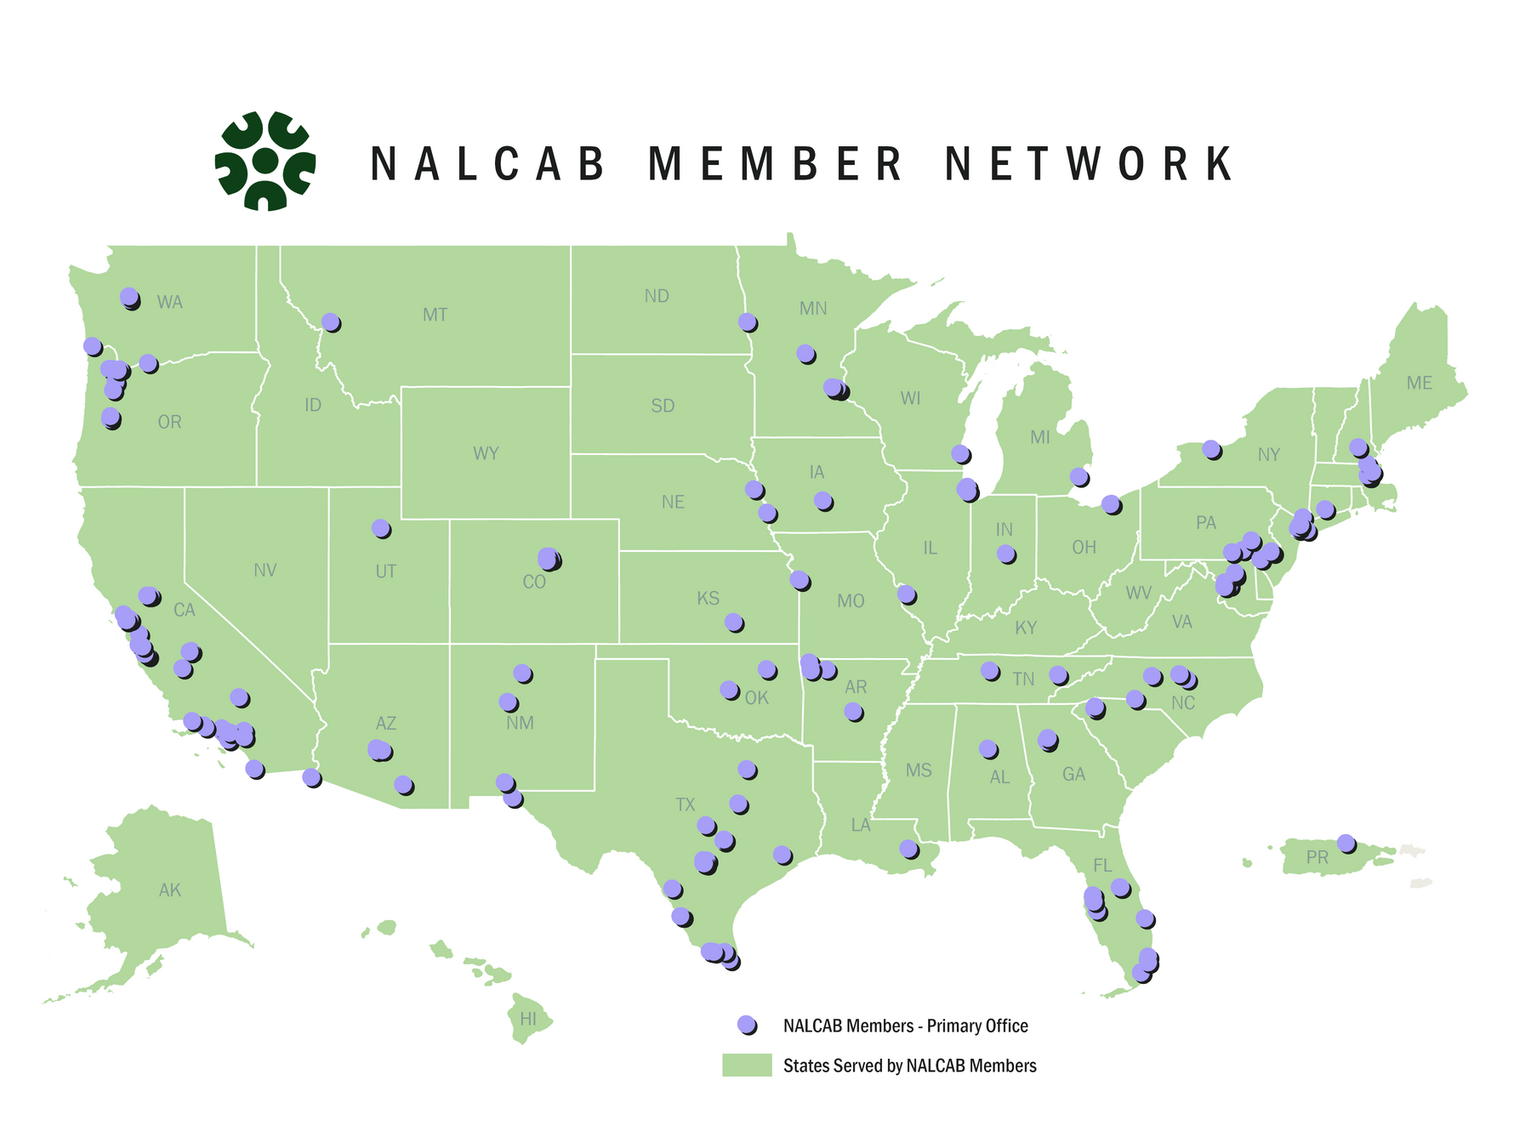
Membership
NALCAB is a non-partisan, one-of-a-kind CDFI intermediary with 200+ CDFI and economic development nonprofit member organizations that are working to maximize the economic contributions of the Latino population to the US economy. Our reach extends across all 50 states, Washington, DC, and Puerto Rico.

Slide 4
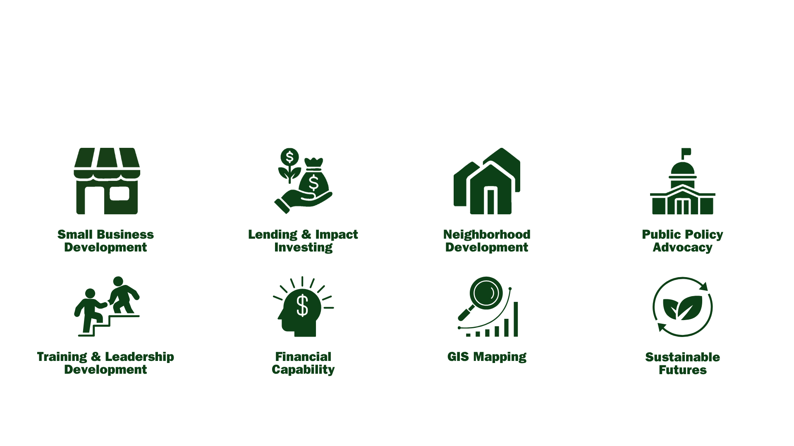
Areas of Expertise

Slide 5

Signature Programs

Slide 6
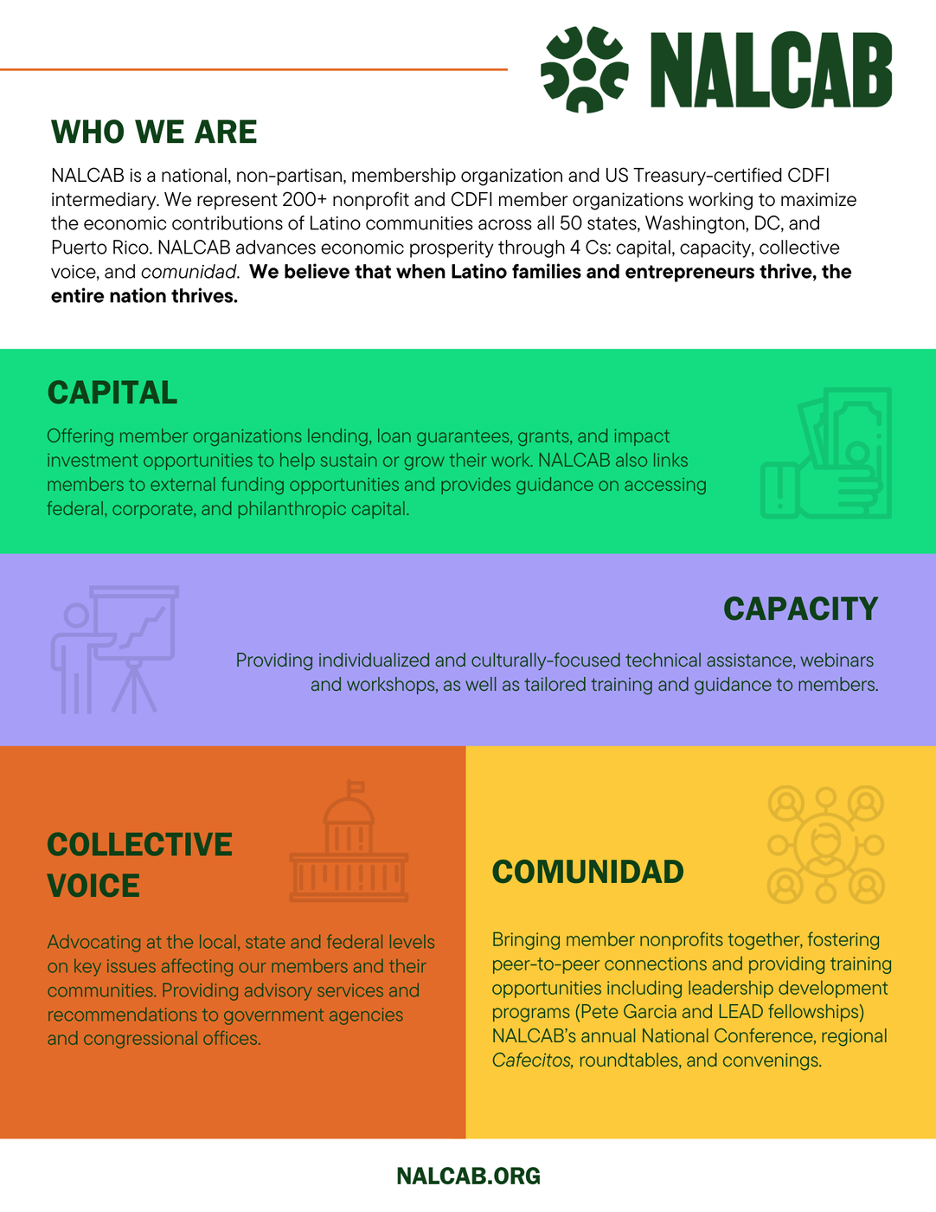
How We Support our Members
The 4 C’s of NALCAB:​

Slide 7
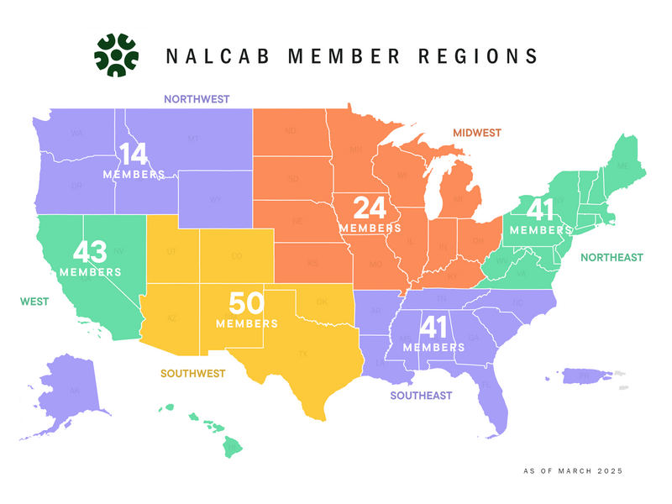
Membership
NALCAB is a non-partisan, one-of-a-kind CDFI intermediary with 200+ CDFI and economic development nonprofit member organizations that are working to maximize the economic contributions of the Latino population to the US economy. Our reach extends across all 50 states, Washington, DC, and Puerto Rico.

Slide 8

  The Acceso Loan Participation Program

Slide 9

  Background
  In 2019, NALCAB received a $10 million grant to establish the Acceso Loan Fund “for the purpose of increasing loan capital for small businesses served by the NALCAB network”. ​
  Responding to the COVID-19 Crisis, Acceso’s priorities shifted and funds were utilized to deploy two rounds of capital totaling $11,620,591 with 3 member lenders in Pennsylvania, California, and Washington, D.C., which have since been fully repaid.​
  In response to Members’ preferences and priorities, Acceso is executing a loan participation strategy to better serve small business lenders in the NALCAB network.​

Slide 10
  Program goals
  Help NALCAB Members increase the number of small business loans they provide to their customers.​
  Improve NALCAB Members’ loan economics and overall profitability of their lending programs. ​
  Help NALCAB Members preserve and expand their relationship with existing customers and increase their reach to prospective customers in their communities. ​
​

Slide 11
  How Does the Program Work?
  NALCAB Members can participate out up to 95% of a small business loan to Acceso while funding the remaining portion and servicing the loans through repayment. ​
  Members collect and keep the entirety of any origination fee charged to their customers and receive a recurring $25 monthly servicing fee from Acceso.​
  Members collect interest and principal payments from their customers and each quarter transfer to Acceso its corresponding portion of interest and principal minus the $25 monthly servicing fee they accrue for servicing the loan in accordance with their respective loan policies and procedures.​
​

Slide 12
  Member Eligibility
  NALCAB Member with Board-approved Loan Policies and Procedures and a small business loan program that has been in place for at least 3 years.​
  Small business loan portfolio’s historical net losses below 10% of total originations.​

Slide 13
  Qualified Loans
  Total Loan amount between $50,000 and $500,000.​
  Fully amortizing term loans (no loans with balloon payments, no lines of credit).​
  Fixed or Variable interest rate (no loans at 0% interest).​
  Secured with collateral according to lender’s policy.​
  Personal guarantee provided by Small Business Owner(s).​
  Loans to qualified Business (continued in next slide…)​

Slide 14
  Qualified Loans
Loans to qualified Business:​
  For profit businesses with Employee Identification Number (EIN). The program is open to business owners that are ITIN holders. ​
  Existing businesses with 1+ years in operations or startups/less than 1 year in operations with alternate source of income.​
  Ability to repay the loan in accordance with lender guidelines, with minimum Debt Service Coverage Ratio (DSCR) of 1.0x (business or global).​
  Business Owners must meet Lender’s credit guidelines.​
  Acceptable industries according to Lender’s guidelines.​
​
NALCAB will evaluate participation requests from Members and decide on purchasing the proposed portion of the loan based on the criteria described above, as well as sector, geographic, and/or lender concentration of Acceso’s loan portfolio and other risk management considerations.​

Slide 15
  Program Mechanics:
  NALCAB Members conduct initial loan underwriting using their own guidelines.​
  NALCAB reviews Member’s participation request and communicates its decision within 2 to 4 business days.​
  If parties decide to move forward, Member and Acceso execute a Loan Participation Agreement (contract template is available for Members to review at any point during the process upon request).​
  Acceso transfers the price of its participation to the Member upon closing of the Member’s loan to its customer and after NALCAB receives a copy of the end loan documentation.​
  Members collect interest and principal payments from their customers and each quarter transfer to Acceso its corresponding portion of interest and principal minus the $25 monthly servicing fee they accrue for servicing the loan in accordance with their respective loan policies and procedures, along with a quarterly portfolio performance report.

Slide 16

  Benefits
Preserve and expand NALCAB Members’ relationships with their small business customers and increase their reach to prospective customers in their communities.​
Grow small business loan portfolio without having to fund 100% of loan proceeds. Free up lending capital for additional reach.​
Improved loan economics and lending program profitability.​
​

Slide 17
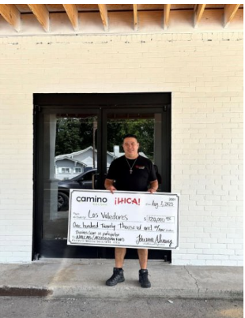
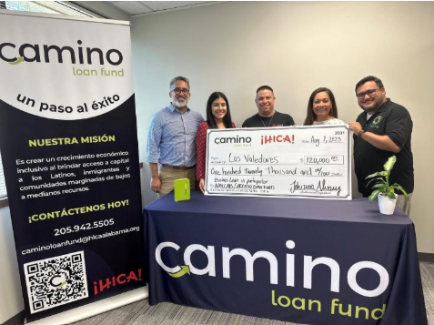
Success Stories
Participation Loan with HICA to fund Los Valedores Mexican Food ​

Slide 18
Q&A
Department Email impactinvesting@nalcab.org​
​
Brenda Lozano
blozano@nalcab.org​
Senior Director of Lending & Asset Management​
​
Melissa Rodriguez​
mrodriguez@nalcab.org​
Sr. Portfolio & Lending Manager
​
Barbara Maldonado
bmaldonado@nalcab.org ​
Lending Program Manager

Slide 19
nalcab.org | info@nalcab.org | NALCAB San Antonio, TX Office: 5404 Wurzbach Rd, San Antonio, TX 78238

